Slide 2
Introduction to the Ethics of Sports Governance
Aims and Objectives
Articulate a variety of definitions of governance
Identify practices in sport which are considered examples of good and bad governance
Recognise the difference between descriptive ethics and normative ethics
Situate ethics within the broader concept of axiology
Downloaded from www.tagsproject.eu

Slide 3
Introduction to the Ethics of Sports Governance
Task 1:
In small groups, discuss what is meant by sports governance
Task 2:
Look at the following definitions of sports governance (next slide) – what are the similarities and differences?
Downloaded from www.tagsproject.eu

Slide 4
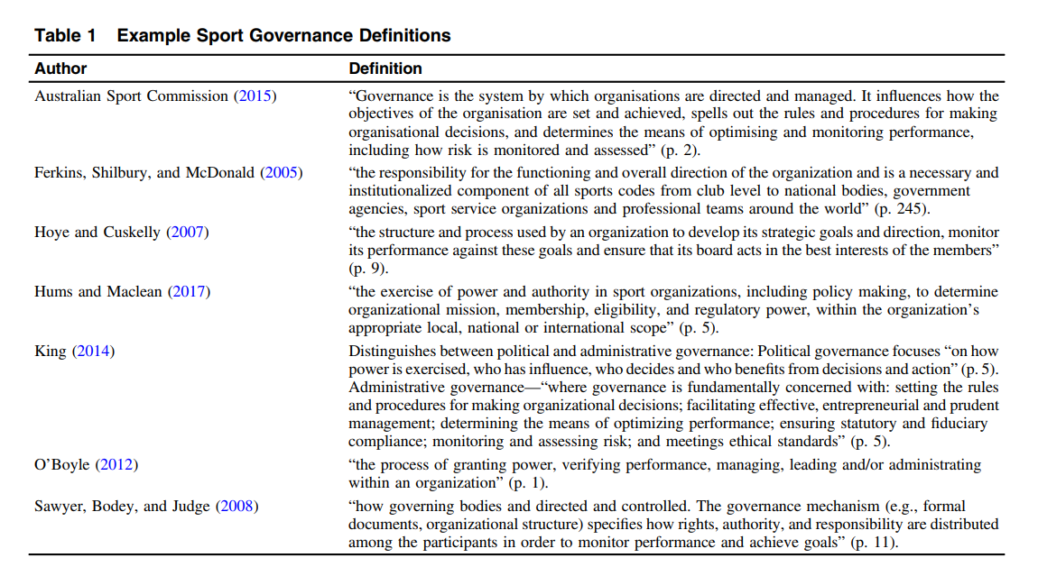
Dowling, M., Leopkey, B. and Smith, L. (2018) Governance in Sport: A Scoping Review. Journal of Sport Management. 32: 439

Slide 5
Henry, I. & Lee, P.C. (2004) Governance and Ethics. In S. Chadwick and J. Beech (eds.) The Business of Sport Management (1st edition). Harlow: Pearson Education Ltd.
Principles of good governance
effectiveness
accountability
transparency
equity
democracy
responsibility
efficiency
Task 3:
Provide an explanation for each of these principles and an example of what this would look like in practice (or a contra-example of what it should not look like)
Downloaded from www.tagsproject.eu

Slide 6
Introduction to the Ethics of Sports Governance
Task 4:
What is meant by ‘ethics’?
Axiology = value
Ethics and morality are often used interchangeably but it is worth thinking of:
Morality = rules and principles guiding right and good action
Ethics = systematic study of these rules and their existence in reality
Ethics
Aesthetics
Morality
Downloaded from www.tagsproject.eu

Slide 7
Introduction to the Ethics of Sports Governance
Task 5:
Consider answers to the following questions
Are there some things in life which are always wrong? (e.g. murder, rape, incest?)
Is what is good and bad dependent on which culture you have been born into?
Do you have a firm idea of what is right and wrong or do you think that what is right and wrong is dependent on context?
Downloaded from www.tagsproject.eu

Slide 8
Relativism v. Universalism
What is good / bad, right / wrong is subjective and flexible
What is good / bad, right / wrong is objective and fixed
Descriptive ethics = describes people’s moral opinions (e.g. psychology / sociology)
Normative ethics = provides a framework for making moral decisions (e.g. virtue theory, utilitarianism, deontology)
Meta-ethics = study of the nature of ethics and morality (e.g. language and meaning of ‘good’, ‘bad’)
Downloaded from www.tagsproject.eu

Slide 9
References / Further Reading:
Culbertson, L., McNamee, M., & Ryall, E. (2008). Resource Guide to the Philosophy of Sport and Ethics of Sport. Hospitality, Leisure, Sport and Tourism Network, 1-43. https://www.heacademy.ac.uk/knowledge-hub/resource-guide-philosophy-sport-and-ethics-sport .
Dowling, M., Leopkey, B. and Smith, L. (2018) Governance in Sport: A Scoping Review. Journal of Sport Management. 32: 439
Henry, I. & Lee, P.C. (2004) Governance and Ethics. In S. Chadwick and J. Beech (eds.) The Business of Sport Management (1st edition). Harlow: Pearson Education Ltd.
Kretchmar, R. S. (2005) Practical Philosophy of Sport and Physical Activity. 2nd Edition. Leeds: Human Kinetics.
Morgan, W.J. (2018) (ed.) Ethics in Sport (3rd Ed.) Leeds: Human Kinetics. ‘Ethics, Ethical Inquiry and Sport: An Introduction’
McNamee, M. J. and Fleming, S. (2007) “Ethics Audits and Corporate Governance: The Case of Public Sector Sports Organizations,” Journal of Business Ethics, 73(4), pp. 425–437.
Morgan, W.J. (2006) Why Sports Morally Matter. London: Routledge.
Ryall, E. (2016) Philosophy of Sport: Key Questions. London: Bloomsbury. Chapter 13 ('What is the value of sport?')
Twietmeyer, G. (2017) Fundamentals of Sports Ethics. Dubuque, IA: Kendall Hunt.
Downloaded from www.tagsproject.eu

