Slide 2
Introduction to legal concepts and principles in sport
Aims and Objectives
Consider and outline a definition of law and how legal rules differ from other normative rules such as social or moral rules.
Recognise how sport operates in a normative rule framework and the basis of the obligation to comply with those rules
Explain what arbitration is and its role in resolving sporting disputes
Explain the differences and relationship between internal rules of sport and external rules of law
Outline some of the reasons why external legal rules and norms increasingly impact on the governance of sport
Identify important legal rules and principles that apply in a sporting context
Downloaded from www.tagsproject.eu

Slide 3
Task 1 – What is ‘law’
In small groups discuss your own understand of what ‘law’ is and identify any common themes that would help you create a working definition
A set or system of rules that:
Apply to everyone
Carry a sanction if breached
Are created by a recognised authority (e.g. the state)
Recognise a process and means of resolving disputes (court)
Recognise a means of enforcement
Do those ‘themes’ accord with your ideas about sporting rules are? If not why not?
Downloaded from www.tagsproject.eu

Slide 4
The autonomy of sport
“The autonomy of sport is ‘an assertion that the sports movement alone understands the unique characteristics (or ‘specificities’) of sport, and therefore knows best how to govern and regulate sport that maximises the benefits to society as a whole’ (Giles and Taylor, 2014).”
i.e. sport is best left to its own devices; free from interference from outside rules and norms
TASK 2 - Apart from a utilitarian ideal about maximising benefits to society, can you think of why else sport should have some autonomy from external moral or legal rules?
Libertarian ideals - Freedom of association/freedom of contract
Downloaded from www.tagsproject.eu

Slide 5
Sporting rules - a voluntarily accepted set of private rules?
National Governing Body
International Federation
Athlete
Downloaded from www.tagsproject.eu

Slide 6
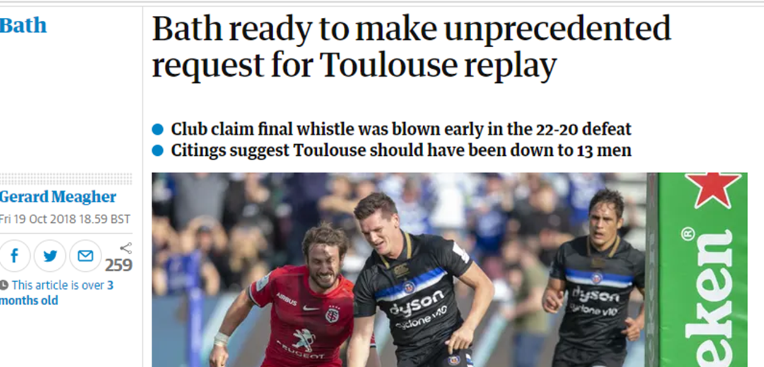
Internal rules of sport – are they laws, do they raise ‘legal’ issues?
Task 3
Given the sporting and financial importance of clubs qualifying for the knock-out phase of Rugby Union’s Heineken cup do you think there were any legal avenues for challenging the application of the rules?
Discuss your views in your group, do you think there should be?
Downloaded from www.tagsproject.eu

Slide 7
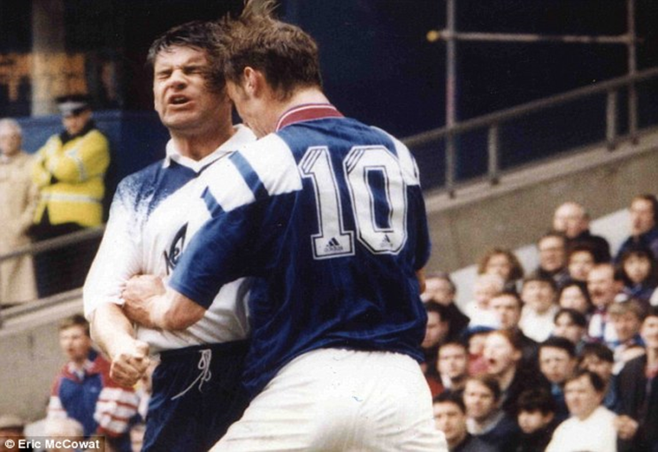
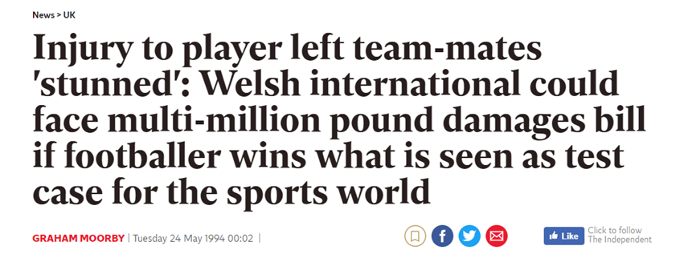
Internal rules of sport and external rules of law
Task 4
When a player commits a foul in football, what rules of the game are breached? Are there any ‘external laws’ that might have been breached?
Using the examples on the slide (the pictures contain hyperlinks), try and identify the sorts of rules and laws that may have been breached and the consequences.
Downloaded from www.tagsproject.eu

Slide 8
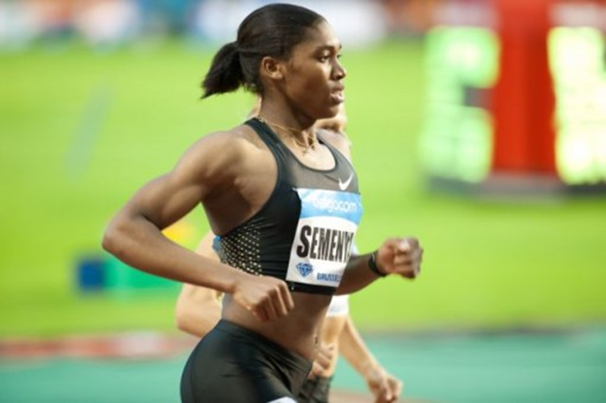
Moral, social and legal norms
Caster Semenya v IAAF (Task 5)
What moral issues are raised by the restricting female athletes with some differences in sexual development and high testosterone levels from competing?
Why do you think this has been a significant ‘legal’ issue? What ‘laws’ might have been breached?
Do you think it is important to be able to challenge sporting organisations through a ‘legal’ avenue?
Downloaded from www.tagsproject.eu

Slide 9
Type of rule
Legal limits on decision making
Rules of the game (in play rules)
Administrative Rules of the sport (e.g. discipline/anti-doping/selection/eligibility)
External legal rules and principles
Sporting rules in a wider context
Referee/umpires decision generally not challengeable
Decisions of SGBs must accord with some basic legal principles (e.g. free from bias, right to put case, be proportionate)
Affecting players and SGBs
Criminal law (e.g. assault), civil law liability (e.g. negligence). EU Law (freedom of movement), Human Rights (discrimination)
Downloaded from www.tagsproject.eu

Slide 10
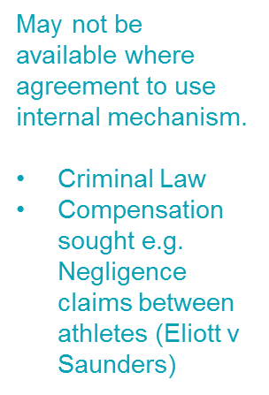
Legal Issues in sport
General law (e.g. ABH, freedom of movement)
Sporting rules - appeal against decision of Governing Body
Arbitration
Resolving legal disputes in sport
National Courts
Independent body, but applying internal rules
Downloaded from www.tagsproject.eu

Slide 11
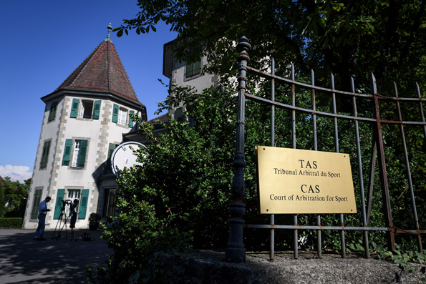
The role of arbitration in resolving sporting disputes
What is arbitration?
‘Alternative’ dispute mechanism
Disputes between athletes and Sport Governing Bodies go before an independent arbitrator or arbitral panel
Arbitrators are ‘sporting experts’, but usually lawyers
Mechanism ‘agreed on’ by the parties to the dispute
Decisions are final and binding
Downloaded from www.tagsproject.eu

Slide 12
How are legal decisions reached?
Identify and interpret relevant internal rules objectively
Identify any relevant external legal rules and consider external legal norms (such as the need for decisions to be free from bias)
Ensure decisions are made in accordance with the relevant internal and external rules
Task 6 – In your groups you will be allocated one of the decisions from the resources.
Downloaded from www.tagsproject.eu

Slide 13
Task 6
In groups you will be allocated one of arbitral decisions from the case compendium that you were asked to review for preparation.
Review the actual decision carefully and try to identify:
What happened (the facts) and the rules that were relevant to the dispute
Whether you think those rules were internal sporting rules or were external (rules that have a wider influence beyond the particular sport)
Whether there were any moral issues that appear to have been raised in the dispute
What the decision/outcome was
Whether, morally, you agreed with the decision
Do you think any lessons could be learnt from the decision?
Downloaded from www.tagsproject.eu

Slide 14
Summary
Sporting rules are not completely autonomous from external legal principles. Ultimately, other than in game decisions, whether an individual has breached the rules or not may well be determined in a legal forum and law is very much a part of sport.
There are certain external legal rules protecting individual’s rights that cannot be ‘ignored’, for example:
Freedom of movement/establishment (Case 23)
Equality (non discrimination)
Proportionality in sanctions (the punishment fits the crime)
Rules must be clear, accessible and consistently applied
Downloaded from www.tagsproject.eu

Slide 15
Summary
Rules will be interpreted objectively, in light of the knowledge and experience of those subject to them
Decisions must be rational and made in accordance with the rules (e.g. all relevant factors must be considered and irrelevant ones ignored) but the outcome does not have to be ethical or ‘fair’. (Case 29)
Minimum requirements of procedural (or ‘natural’) justice must be present (right to a hearing and freedom from bias) (Case 25)
Downloaded from www.tagsproject.eu

Slide 16
References / Further Reading:
Boyes, S, 2012, Sports law: its history and growth and the development of key sources, Legal Information Management, 12 (2012), pp. 86–91
Cooper, J. Testosterone: ‘the Best Discriminating Factor’. Philosophies, 4 (3). p. 36.
https://www.mdpi.com/2409-9287/4/3/36
Foster, K., 2012. Is There a Global Sports Law?, in: Siekmann, R.C.R., Soek, J. (Eds.), Lex Sportiva: What Is Sports Law? T. M. C. Asser Press, The Hague, The Netherlands, pp. 35–52. https://doi.org/10.1007/978-90-6704-829-3_2
Gardiner et al, 2012, Chapters 2 & 3, Sports Law, Routledge, Abingdon
James, M, 2013, Challenging governing bodies before the court of Arbitration for Sport, in James, M: Sports Law, Palgrave Macmillan
K, ‘Lex Sportiva and Lex Ludica: The Court of Arbitration for Sports Disputes’
https://www.researchgate.net/publication/305308468_Lex_Sportiva_and_Lex_Ludica_the_Court_Of_Arbitration_for_Sport's_Jurisprudence
Rigozzi & Mcauliffe, Sports Arbitration https://www.researchgate.net/publication/283896214_Sports_Arbitration
Ryall, E, Cooper J and Ellis L, (2019) Dispute Resolution, Legal Reasoning and Good Governance: learning lessons from appeals on selection in sport. European Sport Management Quarterly. ISSN 1618-4742
Downloaded from www.tagsproject.eu

