Slide 2
Doping in Sport
Aims and Objectives
By the end of the class students will be able to:
define doping and its types
understand the reasons why athletes dope
describe the effects of doping
discuss ethical issues related to doping
suggest interventions and educational programs against doping
make ethical decisions regarding doping related dilemmas
Downloaded from www.tagsproject.eu

Slide 3
Task 1:
In small groups, discuss and define doping
Task 2:
Look at the following slide – Then discus the characteristics and the types of Doping
Downloaded from www.tagsproject.eu

Slide 4
Types of doping
A. Substances & methods prohibited at all times
Prohibited substances: 1. non-approved substances, 2. peptide hormones, growth factors, related substances, and mimetics, 3. beta-2 agonists, 4. hormone and metabolic modulators, 5. diuretics and masking agents
Prohibited methods: 1. manipulation of blood and blood components, 2. chemical and physical manipulation, 3. gene doping
B. Substances & methods prohibited in-competition
Prohibited substances: 6. Stimulants, 7. Narcotics, 8. Cannabinoids, 9. glucocorticoids
C. Substances prohibited in particular sports: 1. Beta-blockers (Archery, automobile, billiards, Darts, Golf, Shooting, Skiing/Snowboarding, aerials/halfpipe and snowboard halfpipe/big air, Underwater sports)
The official text of the Prohibited List shall be maintained by WADA and shall be published in English and French. In the event of any conflict between the English and French versions, the English version shall prevail.
https://www.wada-ama.org/sites/default/files/prohibited_list_2018_en.pdf

Slide 5
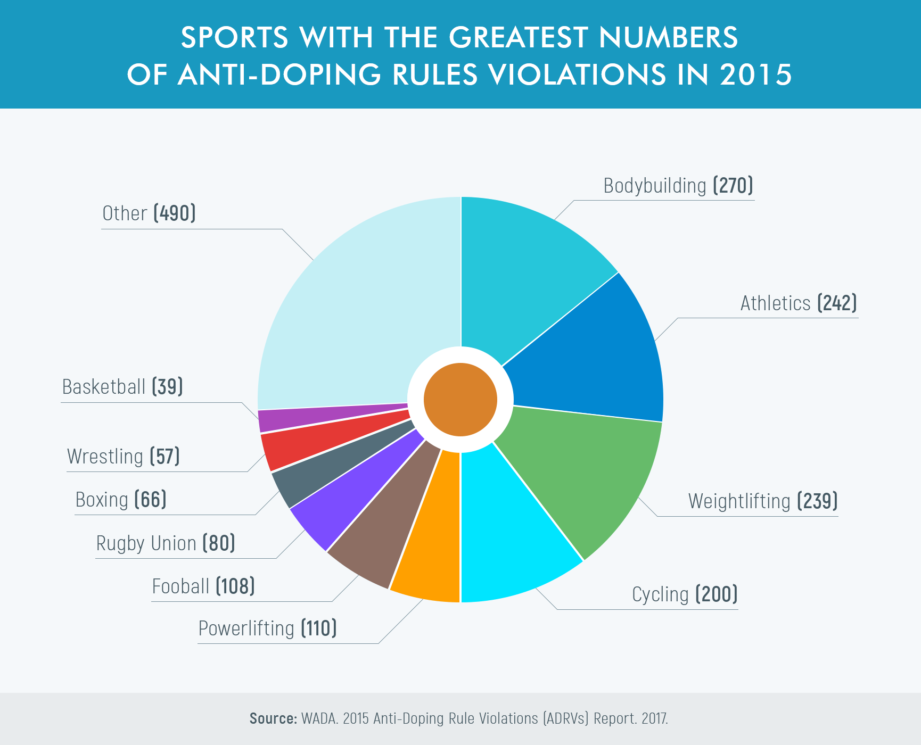
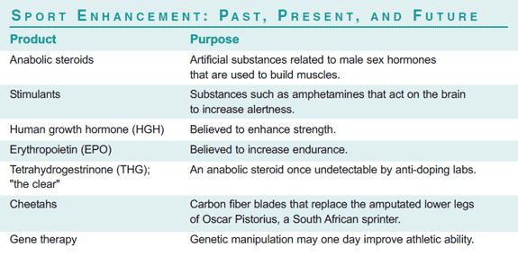
Task 3: Consider the following information and discuss the prevalence of doping and why athletes take drugs

Slide 6
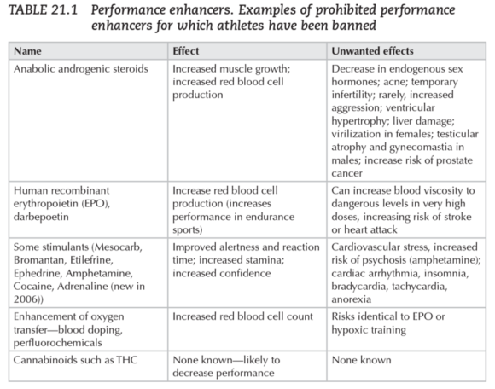
Task 4: Consider the table and discuss the health consequences of doping

Slide 7
Task 5: ‘‘Why not dope?” What are the ethical issues regarding doping?
Doping is cheating, and not ‘‘fair play”.
Doping renders medical risks.
Doping has brought the lawyers into the sporting world, meaning that an athlete (accurately) accused of doping often seeks juridical assistance to find a way to avoid being banned, with the following loss of honour, work (if professional) and money. Consequently, an innocent athlete accused of doping might need a legal adviser to prove his/her innocence. Finally, possession and use of doping agents is according to national laws prohibited in most countries and might carry a penalty of fines or imprisonment.
Scientific studies in sport centres comparing different training methods will be spoiled if some athletes use doping agents during the study period.
Doping destroys the image of sport, traditionally being regarded as ‘‘a sound mind in a sound body”, an image being especially important for our sporting kids and youngsters. We might accept that our adolescent child beats us in tennis after a summer course, but not at the cost of a new extreme muscular size, a dark voice and a fast-growing beard
C. Ehrnborg, T. Rosén / Growth Hormone & IGF Research 19 (2009) 285–287

Slide 8
Task 6: Reflect on and discuss the following doping-related dilemma
Think of yourself as coach of a high level athlete who has lots of chances to participate in the next Olympic Games. Some months before the Olympic Games the athlete suffering of a serious injury and your doctor suggesting the use of some forbidden steroids (doping substances) as the only way for fast recovery and to secure a winning result. The doctor tries to persuade you that would not be detected by an anti-doping control and the athlete would not have any health problems.
Downloaded from www.tagsproject.eu

Slide 9
Task 7: Discuss ways to combat doping. Use the information below to trigger discussions and reflections
The World AntiDoping Agency (WADA) was then founded in 1999, leading to the proposal of the World Anti-Doping Code (WADA Code) in 2003. Every year since then, the WADA has published the list of prohibited classes of substances and prohibited methods and most nations and sports-governing bodies adhere to these guidelines
“Scarpino et al. (1990) - 21% of doctors believed that doping practices can enhance athletic performance; 20% of technicians (which included the doctor sample) believed that anabolic steroids were frequently used by top level athletes
Greenway and Greenway (1997) 18% had either prescribed or been asked to prescribe anabolic steroids for performance enhancement or body image purposes
“Self-reports showed a consensus amongst medical practitioners that they have a role to play in doping preventions. Specifically, 92% and 89% (Laure et al., 2003; Woods & Moynihan, 2009) of GPs and 91% of retail pharmacists (Laure & Kriebitzsch-Lejeune, 2000) agreed with this proposition
The Olympic oath shall be extended to coaches and other officials, and shall include the respect of integrity, ethics and fair play in sport. Educational and preventive campaigns will be intensified, focusing principally on youth, and athletes and their entourage. Complete transparency shall be assured in all activities to fight doping, except for preserving the confidentiality necessary to protect the fundamental rights of athletes. Partnership with the media shall be sought in anti-doping campaigns.
The University Anti-Doping Textbook: Anti-Doping Learning Hub, ttp://www.antidopinglearninghub.org/sites/default/files/
Downloaded from www.tagsproject.eu

Slide 10
References / Further Reading:
Elbe, A. M., & Brand, R. (2016). The effect of an ethical decision-making training on young athletes’ attitudes toward doping. Ethics & Behavior, 26(1), 32-44. DOI:10.1080/10508422.2014.976864
Barkoukis, V., Lazuras, L., Tsorbatzoudis, H., & Rodafinos, A. (2013). Motivational and social cognitive predictors of doping intentions in elite sports: An integrated approach. Scandinavian journal of medicine & science in sports, 23(5), 330-340. https://doi.org/10.1111/sms.12068
Barkoukis, V., Lazuras, L., & Harris, P. R. (2015). The effects of self-affirmation manipulation on decision making about doping use in elite athletes. Psychology of Sport and Exercise, 16, 175-181.
Laure, P. & Binsinger, C. (2007). Doping Prevalence among Preadolescent Athletes: A 4-Year Follow-Up. British Journal of Sports Medicine, 41, 660-663. http://dx.doi.org/10.1136/bjsm.2007.035733
Lazuras, L., Barkoukis, V., Rodafinos, A., & Tzorbatzoudis, H. (2010). Predictors of doping intentions in elite-level athletes: a social cognition approach. Journal of Sport and Exercise Psychology, 32(5), 694-710.
Lazuras, L., Barkoukis, V., & Tsorbatzoudis, H. (2015). Toward an integrative model of doping use: an empirical study with adolescent athletes. Journal of Sport and Exercise Psychology, 37(1), 37-50.
Morente-Sánchez, J. and Zabala, M. (2013) Doping in Sport: A Review of Elite Athletes’ Attitudes, Beliefs, and Knowledge. Sports Medicine, 43, 395-411. http://dx.doi.org/10.1007/s40279-013-0037-x
Ntoumanis, N., Ng, J. Y., Barkoukis, V., & Backhouse, S. (2014). Personal and psychosocial predictors of doping use in physical activity settings: a meta-analysis. Sports Medicine, 44(11), 1603-1624.
Psouni, S., Zourbanos, N., & Theodorakis, Y. (2015). Attitudes and intentions of Greek athletes and coaches regarding doping. Health, 7(09), 1224-1233. http://dx.doi.org/10.4236/health.2015.79137
Downloaded from www.tagsproject.eu

